Slide 2
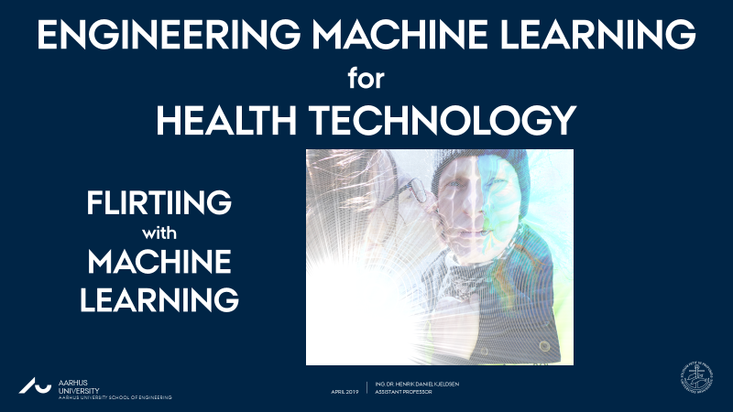

TRANSFER LEARNING
ENGINEERING MACHINE LEARNING
HEALTH TECHNOLOGY

Slide 3

TRANSFER LEARNING
Convolutional neural networks require lots of data and lots of compute power!
What if you have neither?
TRANSFER LEARNING:
Re-use already trained network
for new (possibly related) task.

Slide 4
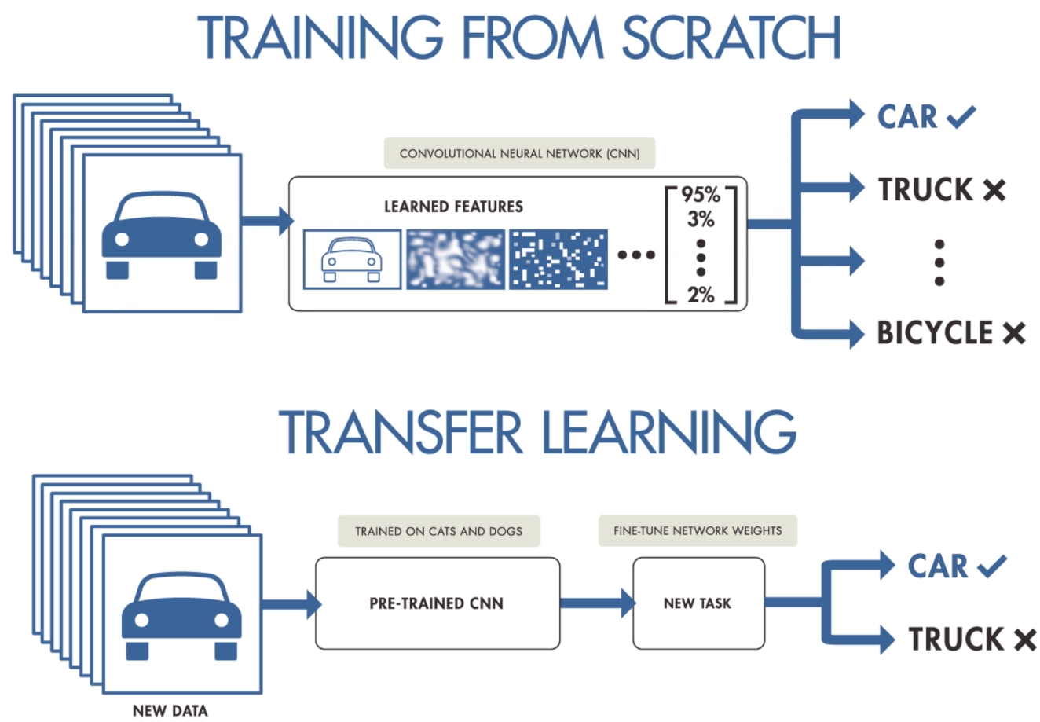
TRANSFER LEARNING
Convolutional neural networks require lots of data and lots of compute power.
What if you have neither?
TRANSFER LEARNING:
Re-use already trained network
for new (possibly related) task.

Slide 5
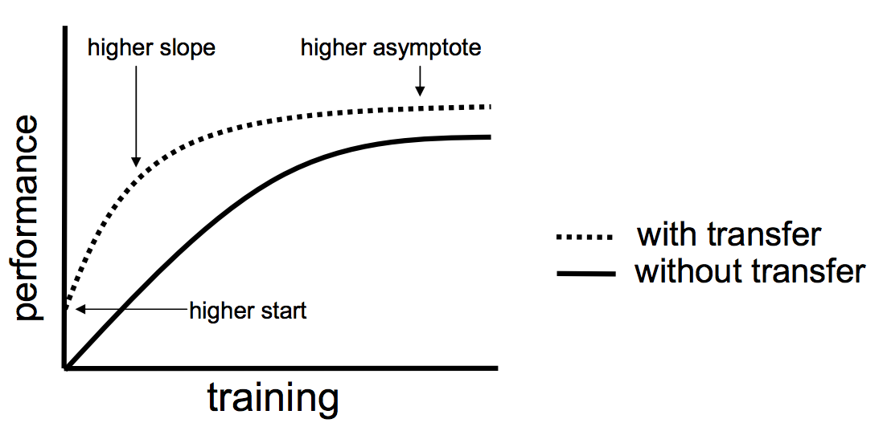
TRANSFER LEARNING
Convolutional neural networks require lots of data and lots of compute power.
What if you have neither?
TRANSFER LEARNING:
Re-use already trained network
for new (possibly related) task.

Slide 6
TRANSFER LEARNING
Convolutional neural networks require lots of data and lots of compute power.
What if you have neither?
TRANSFER LEARNING:
Transfer learning via feature extraction.
Transfer learning via fine turning.

Slide 7

TRANSFER LEARNING VIA FEATURE EXTRACTION

Slide 8
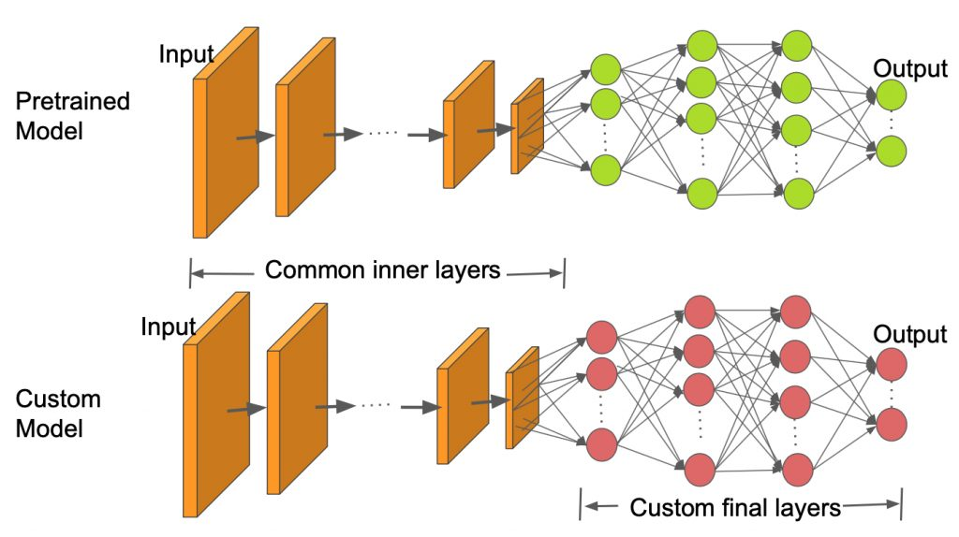
TRANSFER LEARNING VIA FEATURE EXTRACTION

Slide 9
TRANSFER LEARNING VIA FEATURE EXTRACTION
Logistic Regression
Linear SVM
Naïve Bayes
Etc.
SIMPLE MODELS

Slide 10
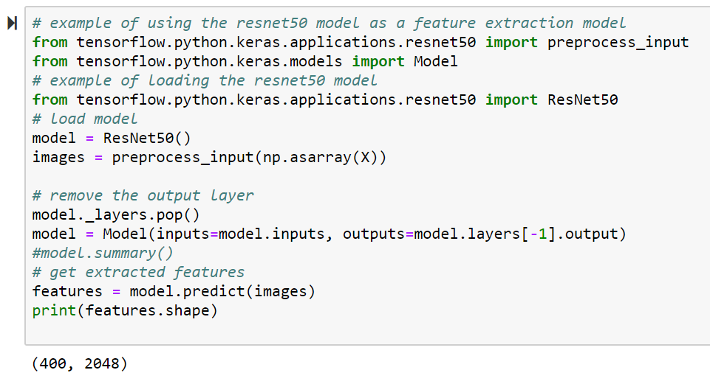
TRANSFER LEARNING VIA FEATURE EXTRACTION

Slide 11
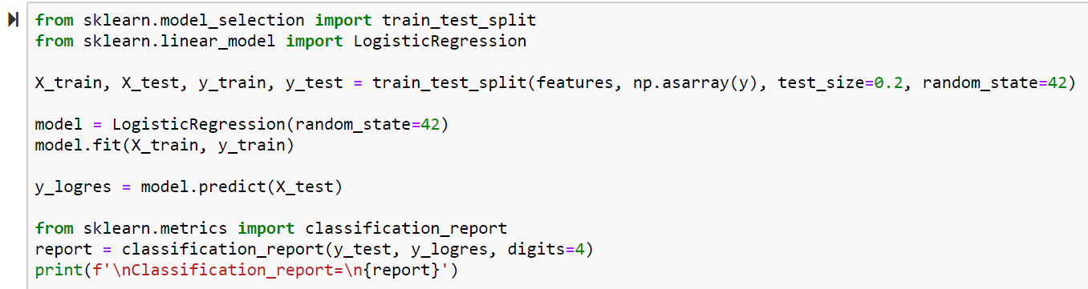
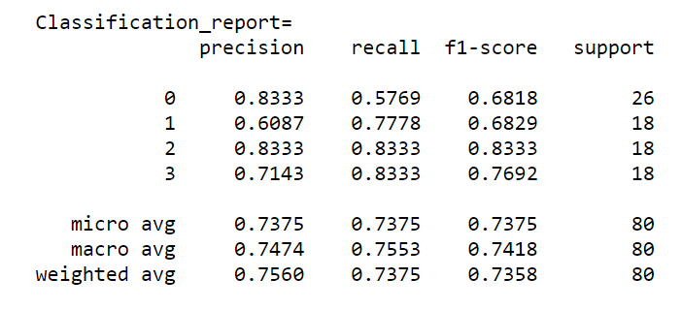
TRANSFER LEARNING VIA FEATURE EXTRACTION

Slide 12
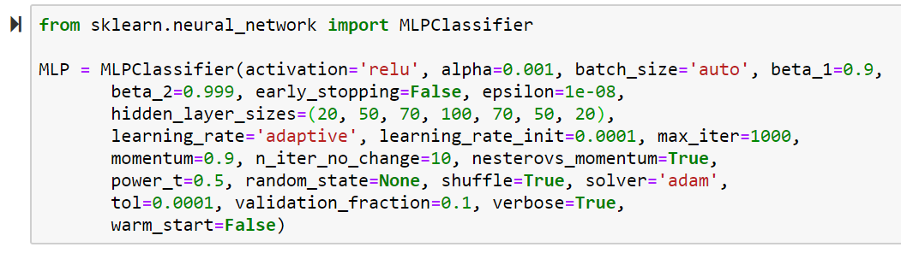
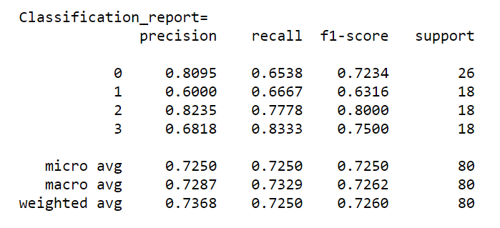
TRANSFER LEARNING VIA FEATURE EXTRACTION

Slide 13
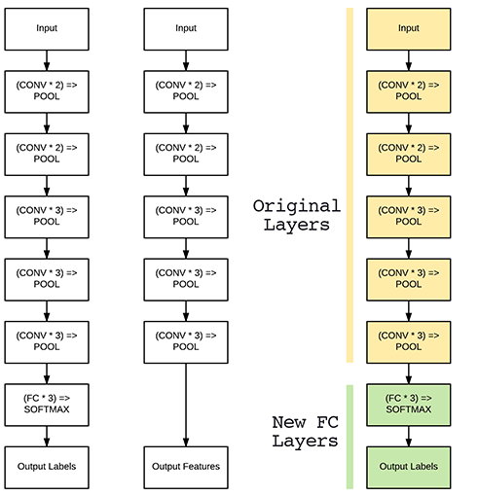
TRANSFER LEARNING VIA FINE TUNING
https://www.pyimagesearch.com/2019/06/03/fine-tuning-with-keras-and-deep-learning/

Slide 14
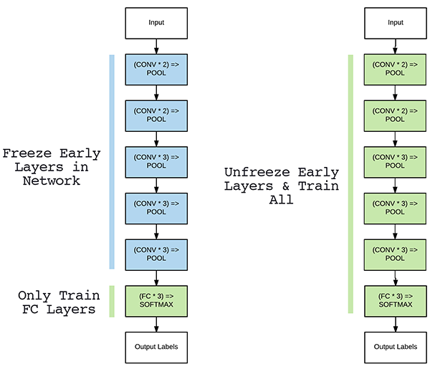
TRANSFER LEARNING VIA FINE TUNING
STEP 1
STEP 2
https://www.pyimagesearch.com/2019/06/03/fine-tuning-with-keras-and-deep-learning/

Slide 15
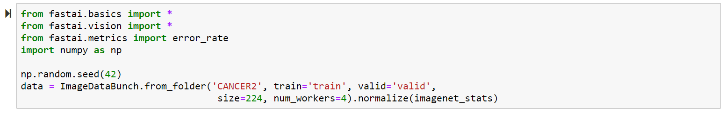
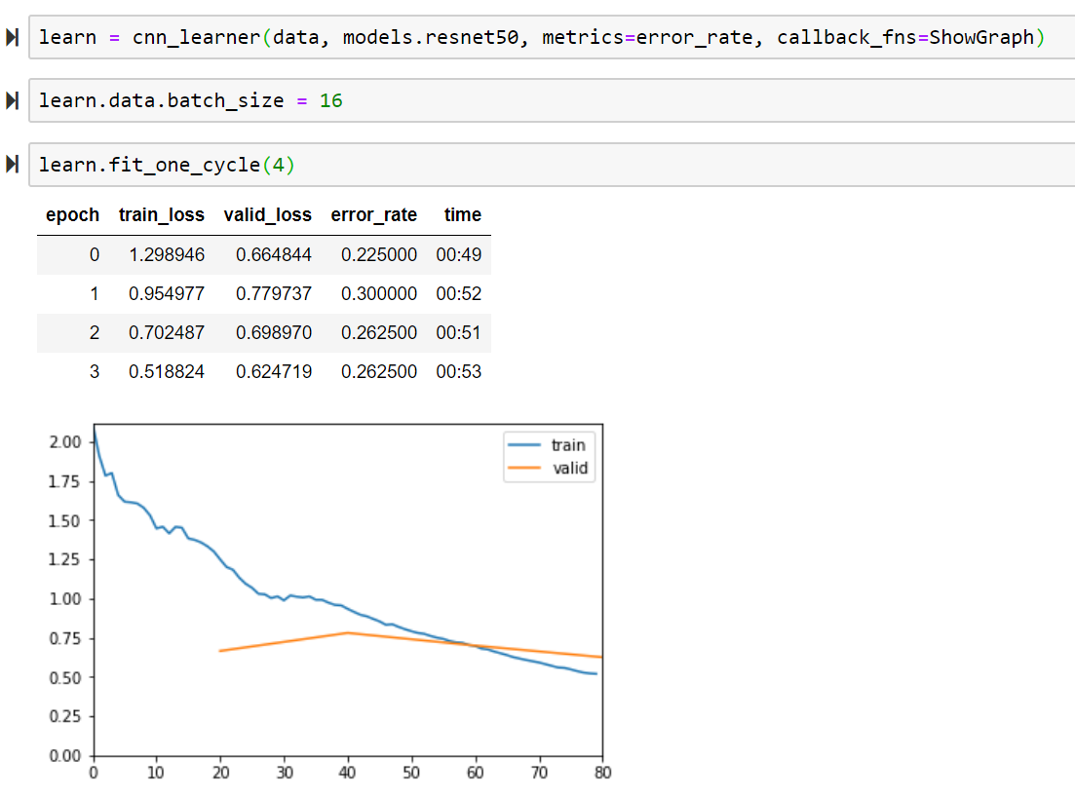
TRANSFER LEARNING VIA FINE TUNING
STEP 1

Slide 16
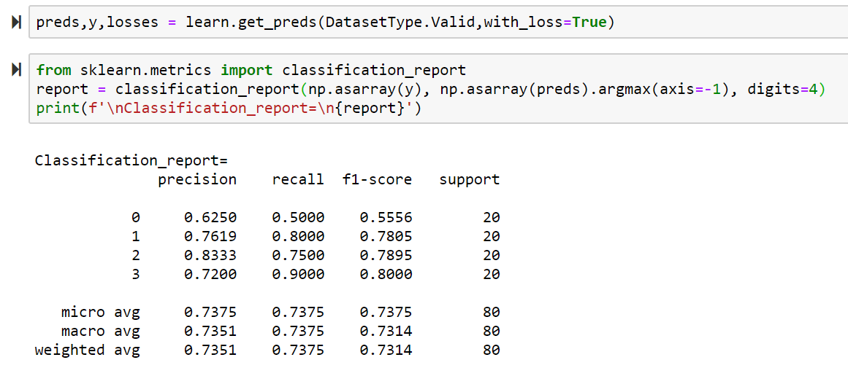
TRANSFER LEARNING VIA FINE TUNING

Slide 17
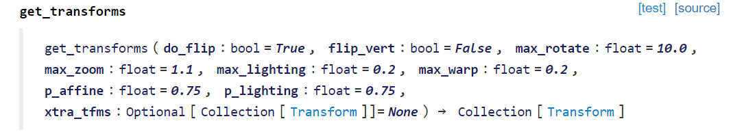
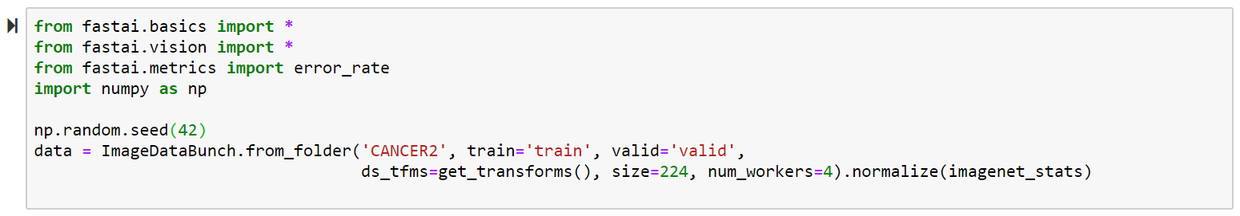
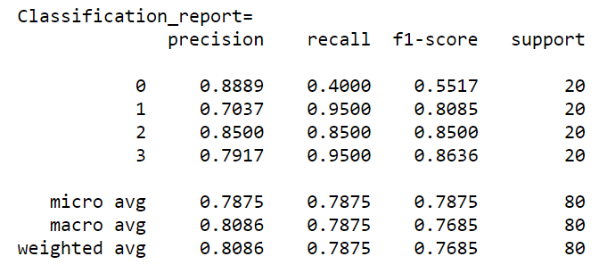
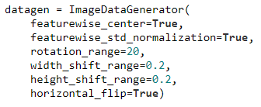
TRANSFER LEARNING VIA FINE TUNING
KERAS AUGMENTATION:

Slide 18
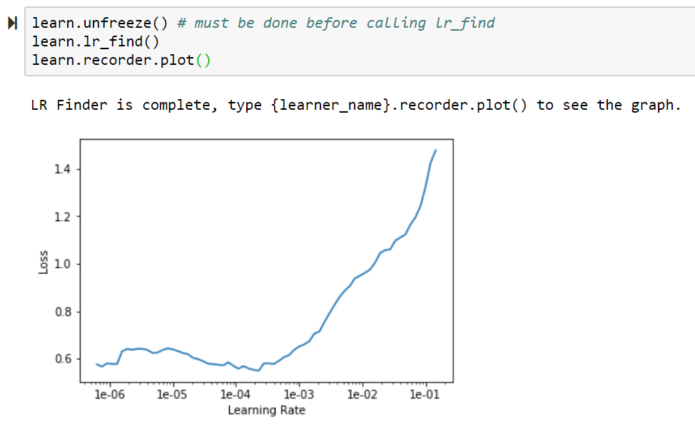
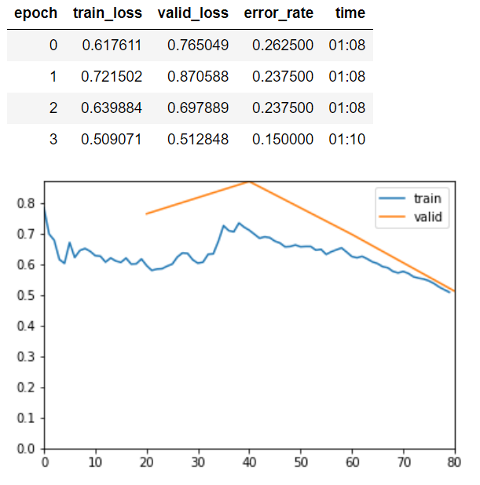
TRANSFER LEARNING VIA FINE TUNING
STEP 2

Slide 19
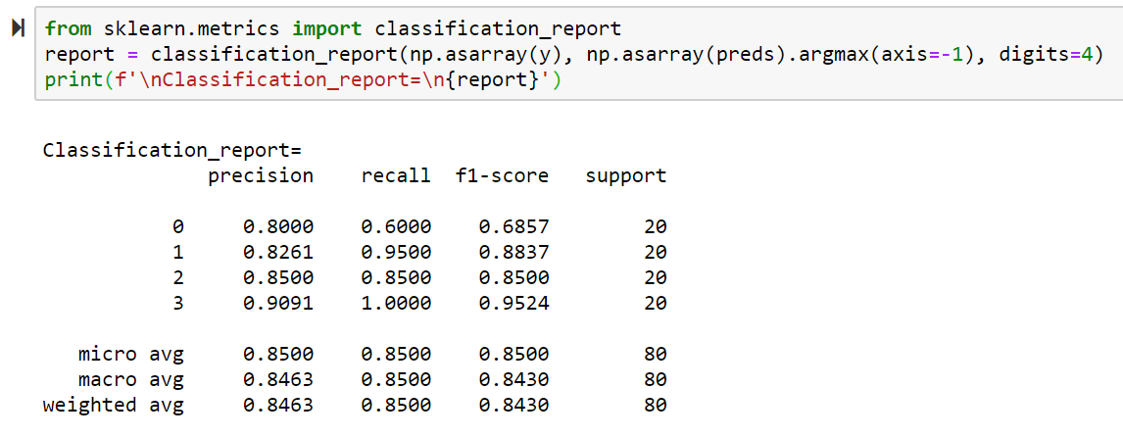
TRANSFER LEARNING VIA FINE TUNING
STEP 2

Slide 20
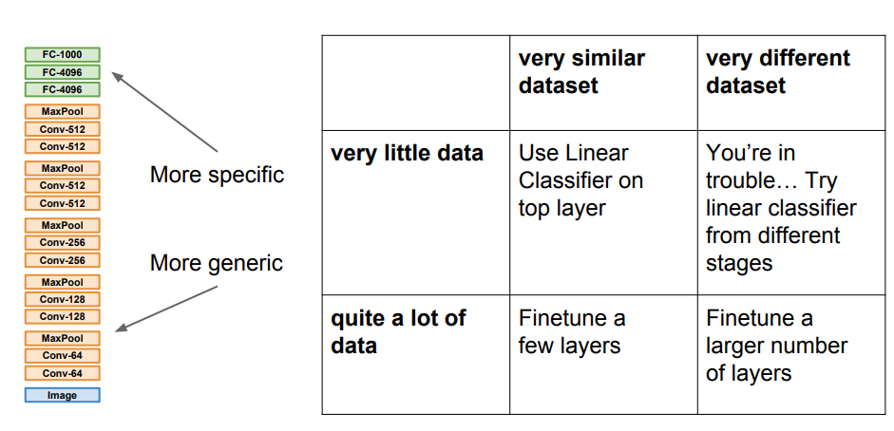
TRANSFER LEARNING

